Slide 1
CSCNSI
Network Booting

Slide 2
Introduction
Introduction
Preboot Execution Environment (PXE)
Trivial File Transfer Protocol (TFTP)
Anaconda INstaller and Kickstart Scripts

Slide 3
Network Booting

Slide 4
Network Booting
Introduction
There are many ways to boot from the network
Preboot Execution Environment (PXE)
TFTP
iPXE (formerly gPXE, which if formerly Etherboot)
HTTP; WiFi; iSCSI; others
Initial environment is downloaded from server, loaded into memory, and executed
Usually image is very small

Slide 5
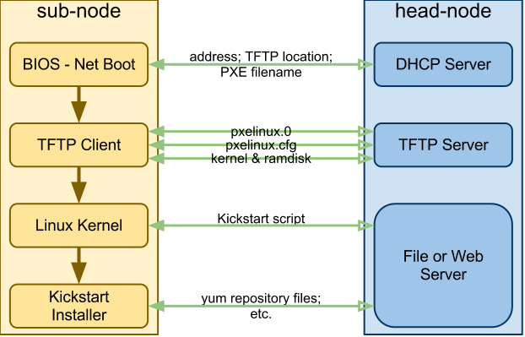

Slide 6
Preboot Execution Environment (PXE)
via Syslinux

Slide 7
PXE
Introduction
Allows booting of node using network device
The environment is passed to the booting node via TFTP
We’re using the Syslinux boot image set for simplicity

Slide 10
PXE
Syslinux Installation
Collection of files for network booting
Served by a TFTP server
Includes boot image
Includes some utilities
DHCP server’s response can point to TFTP server and the initial boot image to download
Syslinux appears to the user as a simple menu system

Slide 11
PXE
Configuration
Configure your DHCP server to include
The ‘next-server’ (your TFTP server)
The ‘filename’ of the boot image on that server
Standard boot image will have the node search for a config file named with:
Complete hardware MAC address
Complete uppercase hexadecimal IP address
Tries to resolve one hex digit at a time

Slide 12
PXE
Configuration
/pxelinux.cfg/5f9ddfb9-3270-4d62-95d7-0273f1caa68d /pxelinux.cfg/01-08-00-27-dd-a0-65 /pxelinux.cfg/C000025B /pxelinux.cfg/C000025 /pxelinux.cfg/C00002 /pxelinux.cfg/C0000 /pxelinux.cfg/C000 /pxelinux.cfg/C00 /pxelinux.cfg/C0 /pxelinux.cfg/C /pxelinux.cfg/default

Slide 13
Trivial File Transfer Protocol (TFTP)
Network Booting

Slide 14
CSCNSI
Network Booting

Slide 15
Summary
Introduction
Preboot Execution Environment (PXE)
Trivial File Transfer Protocol (TFTP)
Anaconda INstaller and Kickstart Scripts

